Slide 1
高级算法扩展(一) Rolling Hash
Rabin-Karp algorithm
1044. Longest Duplicate Substring
1062. Longest Repeating Substring
1392. Longest Happy Prefix
1316. Distinct Echo Substrings
214. Shortest Palindrome
718. Maximum Length of Repeated Subarray
1147. Longest Chunked Palindrome Decomposition
你们的好朋友Eddie

Slide 2
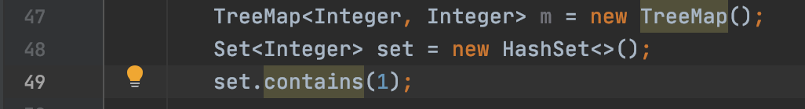
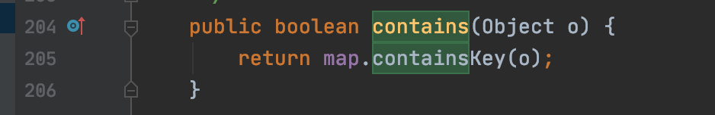
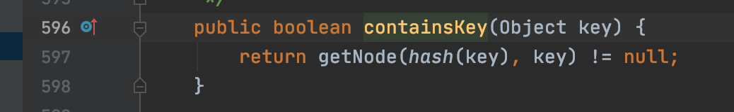
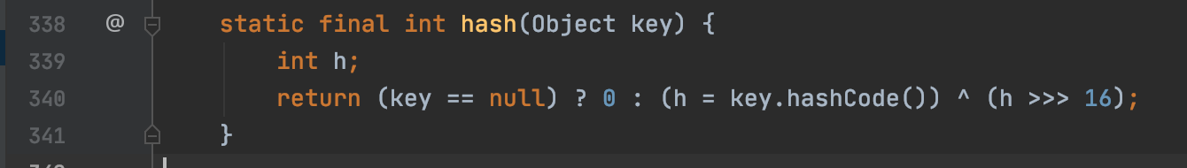
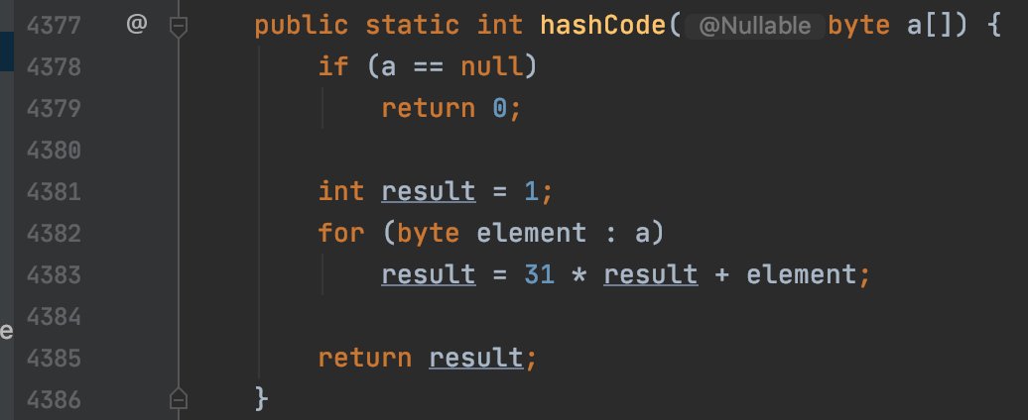
Use java set.contains as an example

Slide 3
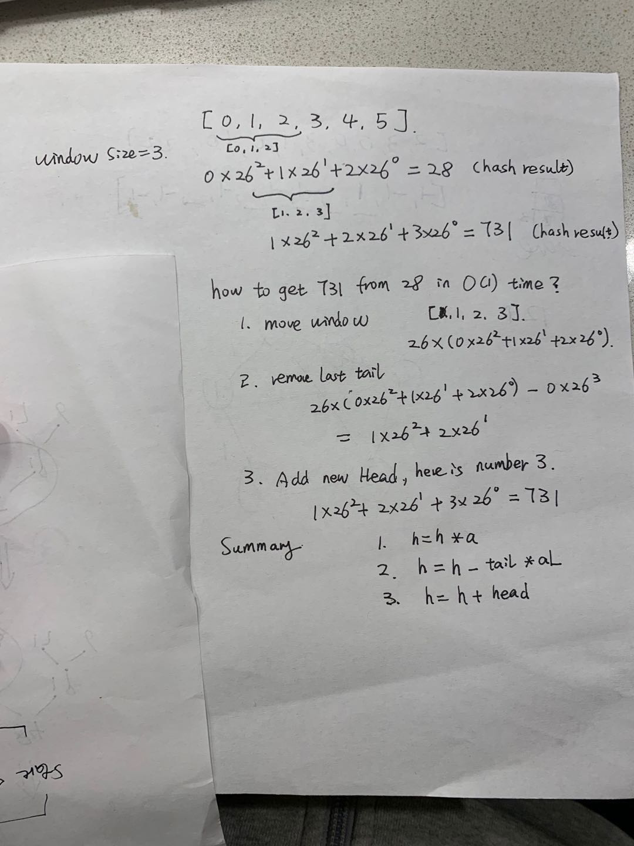
What is rolling hash?
Rolling hash is to use sliding window way to calculate the “hashCode” of every element inside the window. And when the window moving, we can use O(1) time to get next hash value of the window.
For example (0,1,2) hash value = 28
Next window (1,2,3) hash value = 731
We can get 28 -> 731 in O(1) time using rolling hash

Slide 4
It’s real name is Rabin-Karp
In computer science, the Rabin–Karp algorithm or Karp–Rabin algorithm is a string-searching algorithm created by Richard M. Karp and Michael O. Rabin (1987) that uses hashing to find an exact match of a pattern string in a text. It uses a rolling hash to quickly filter out positions of the text that cannot match the pattern, and then checks for a match at the remaining positions. Generalizations of the same idea can be used to find more than one match of a single pattern, or to find matches for more than one pattern.

Slide 5
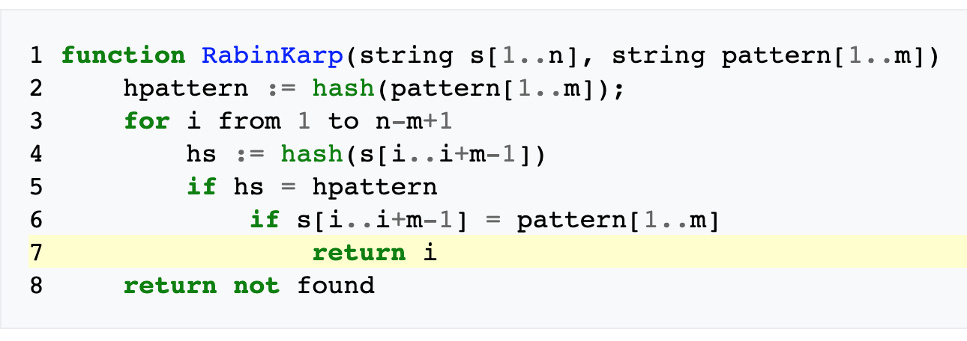
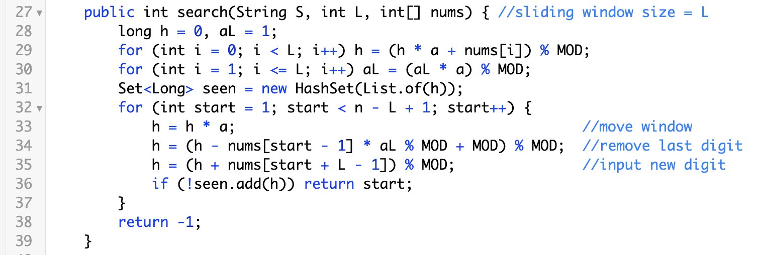

Slide 6
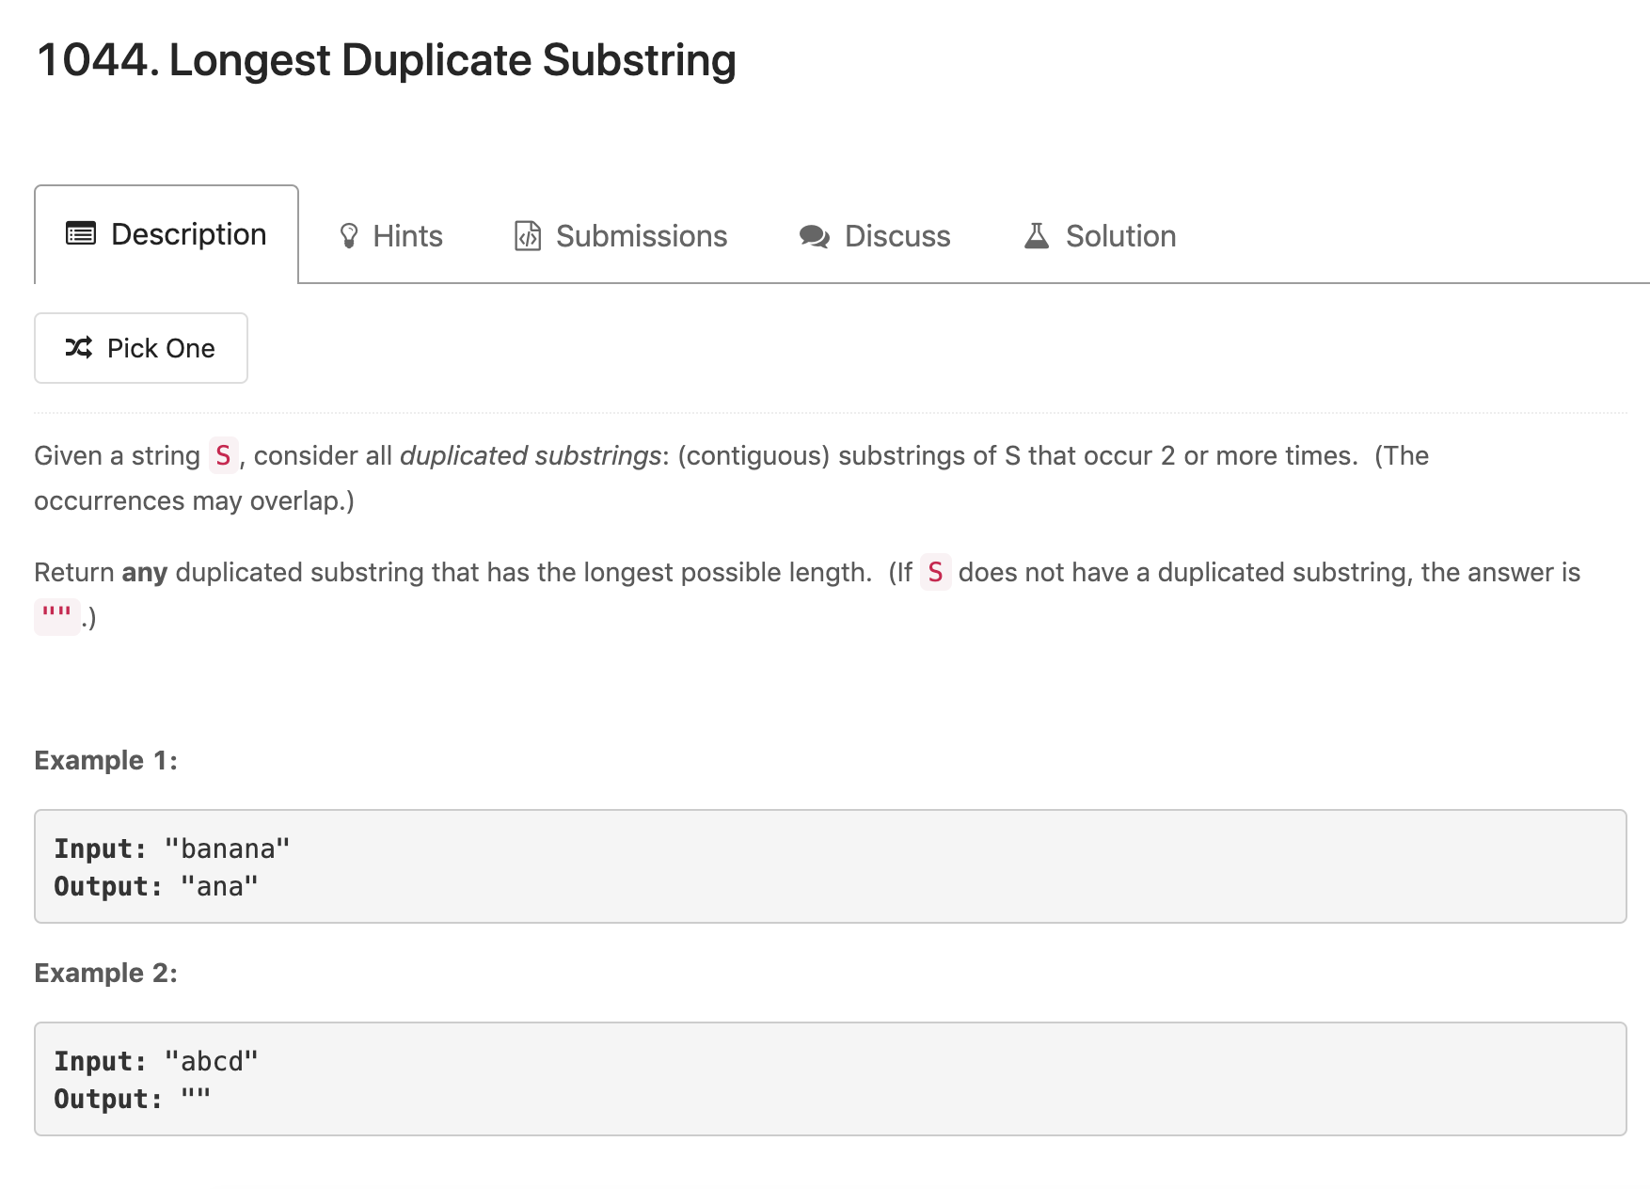
Binary search +
Rolling hash template
Now require result content

Slide 7
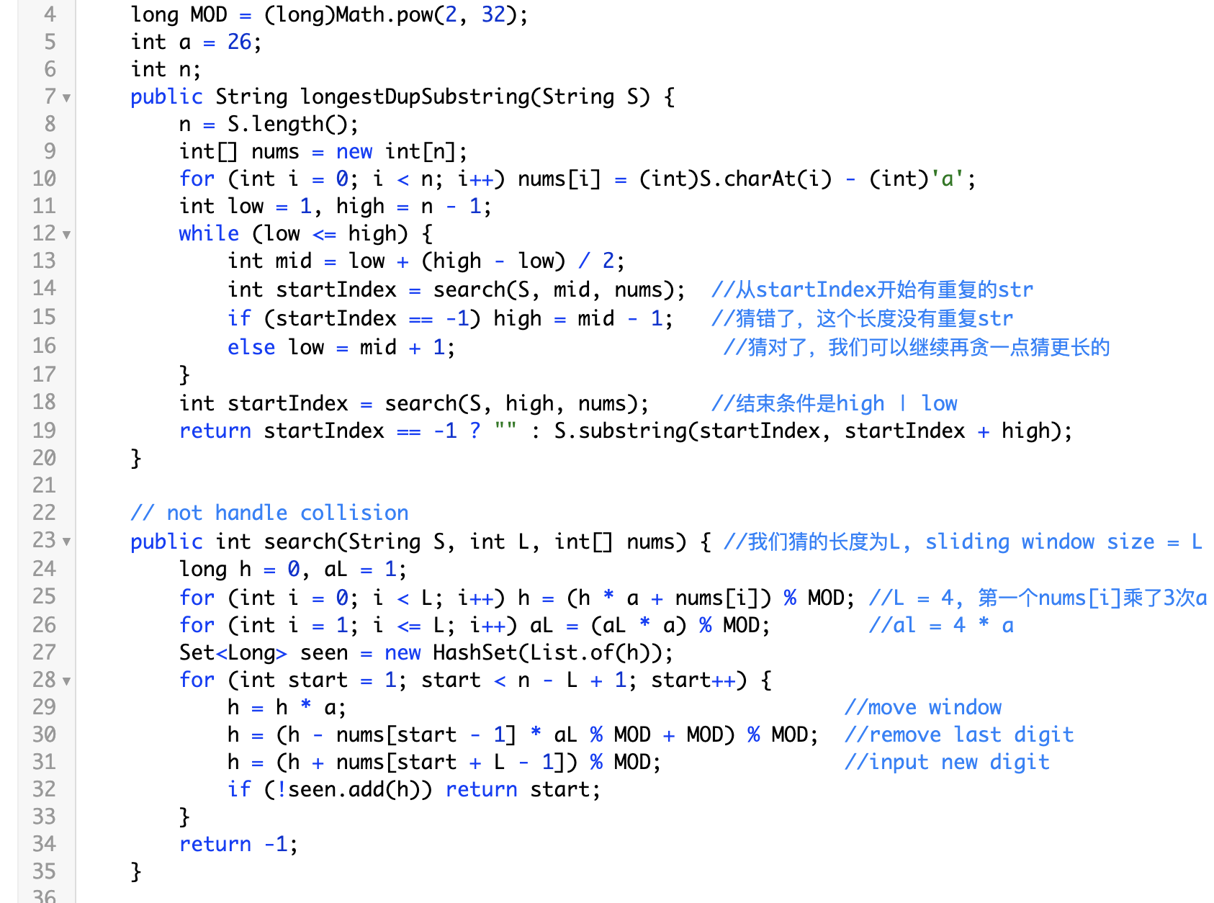
Banana
[ban] -> 2
[ana] -> 1
[nan] -> 3
[ana] -> 1
We find a match
[ana] == [ana]

Slide 8
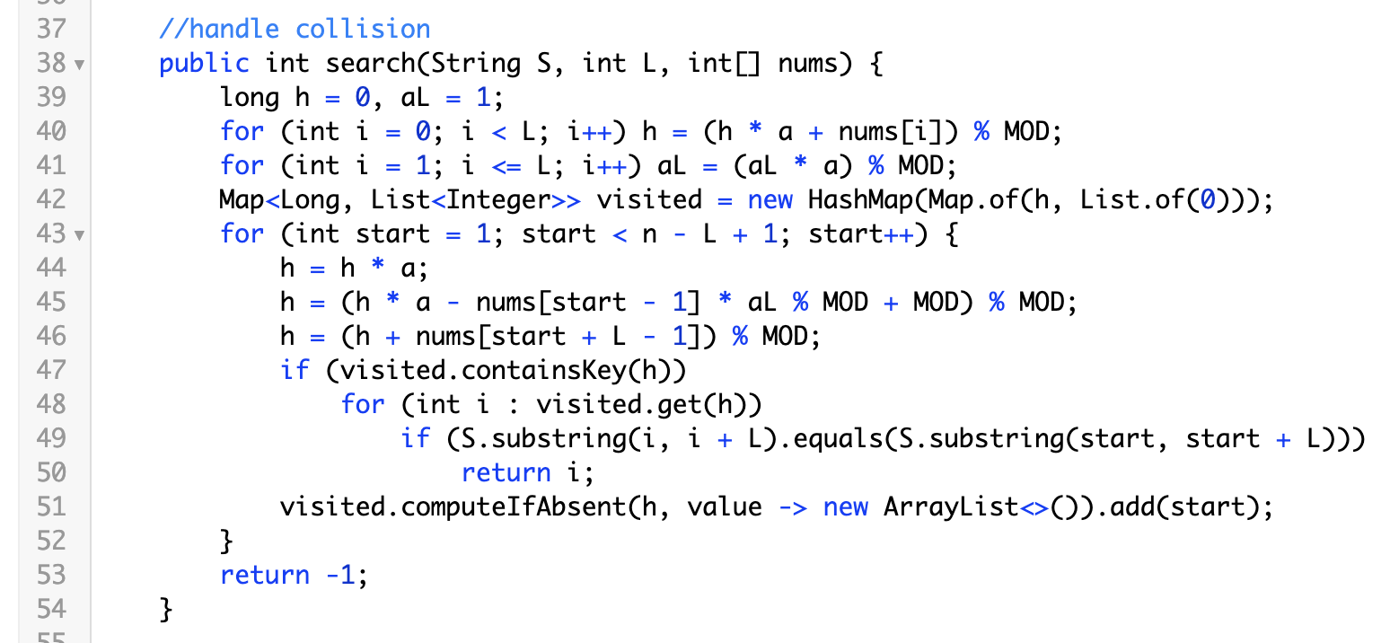
We can handle collision by store the start index of string if their hash value is same. We compare string all length if we meet same hash value.

Slide 9
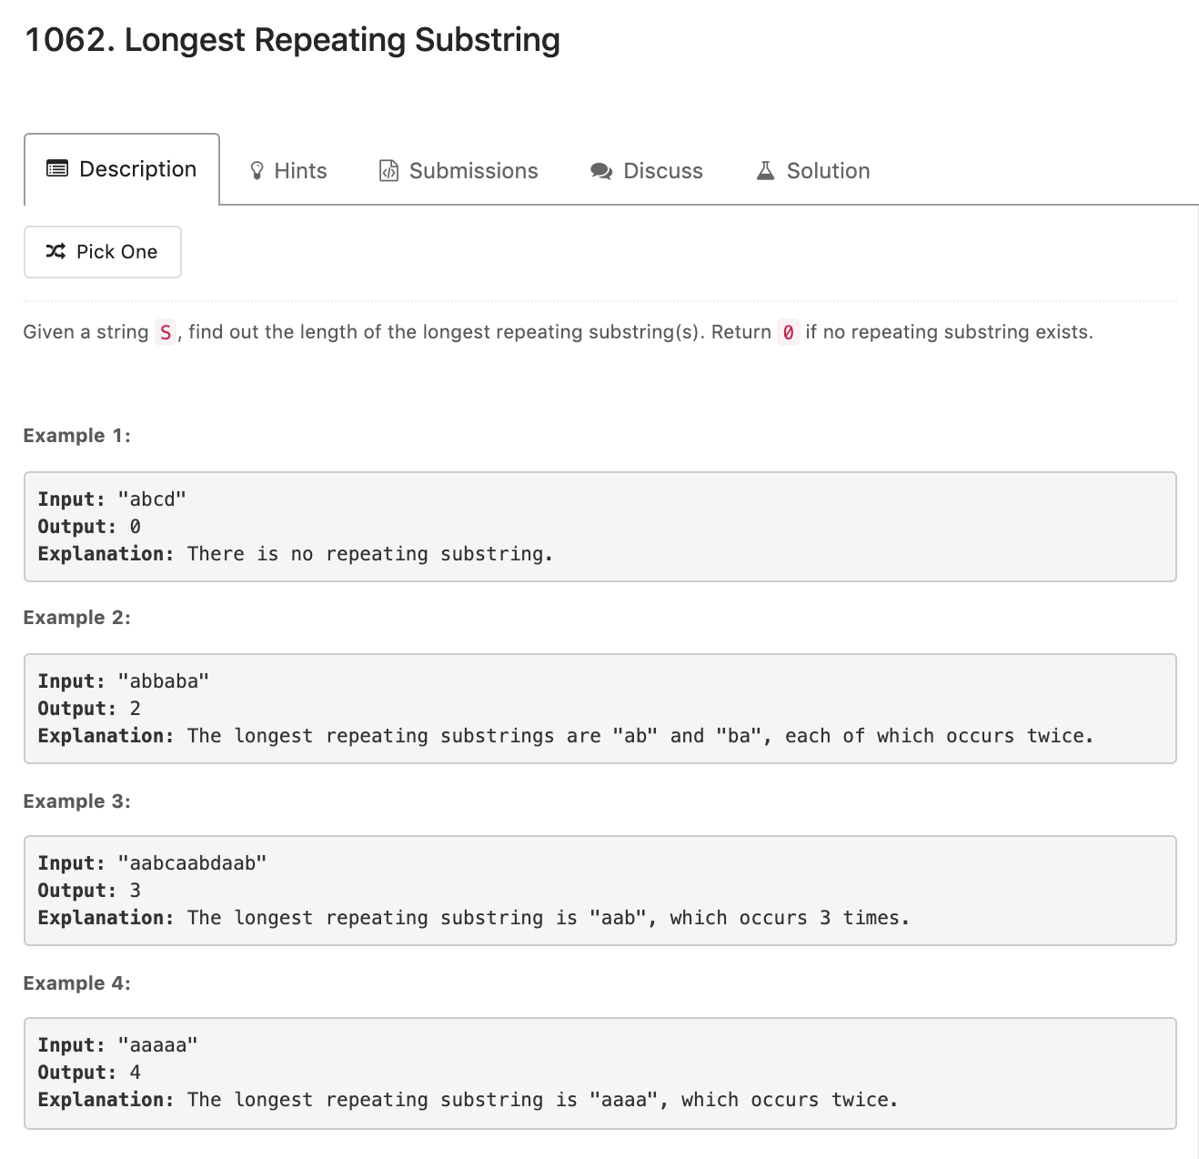
Binary search +
Rolling hash template
Only require length

Slide 10
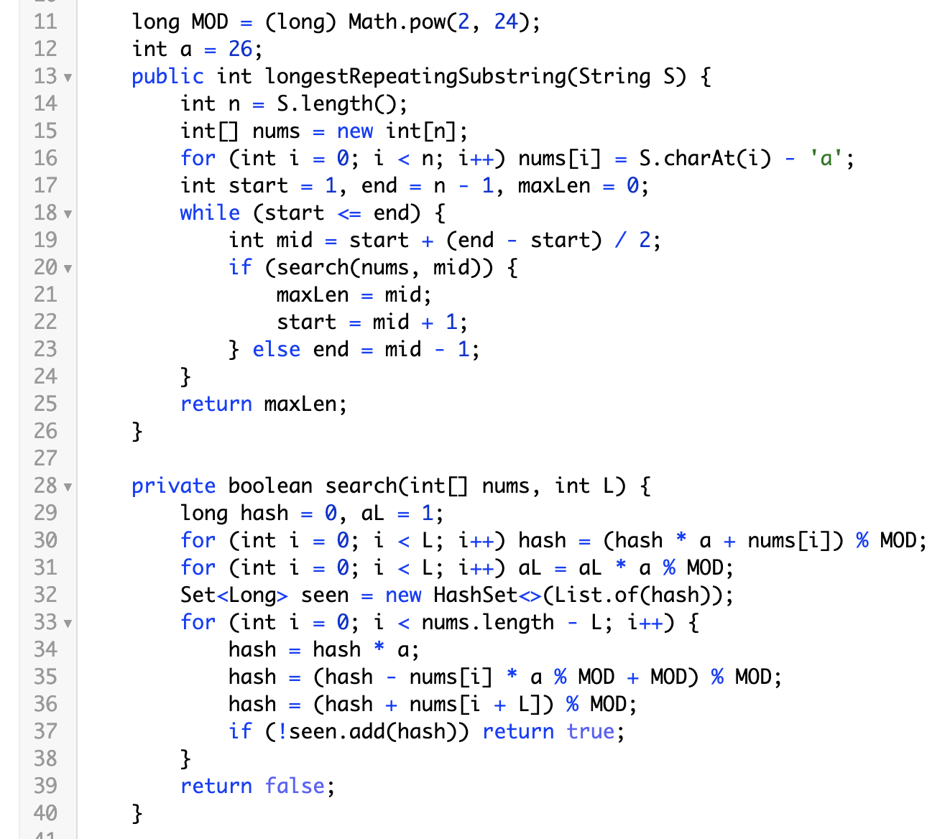
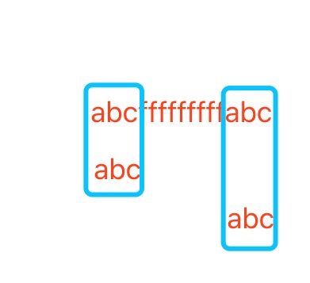

Slide 11
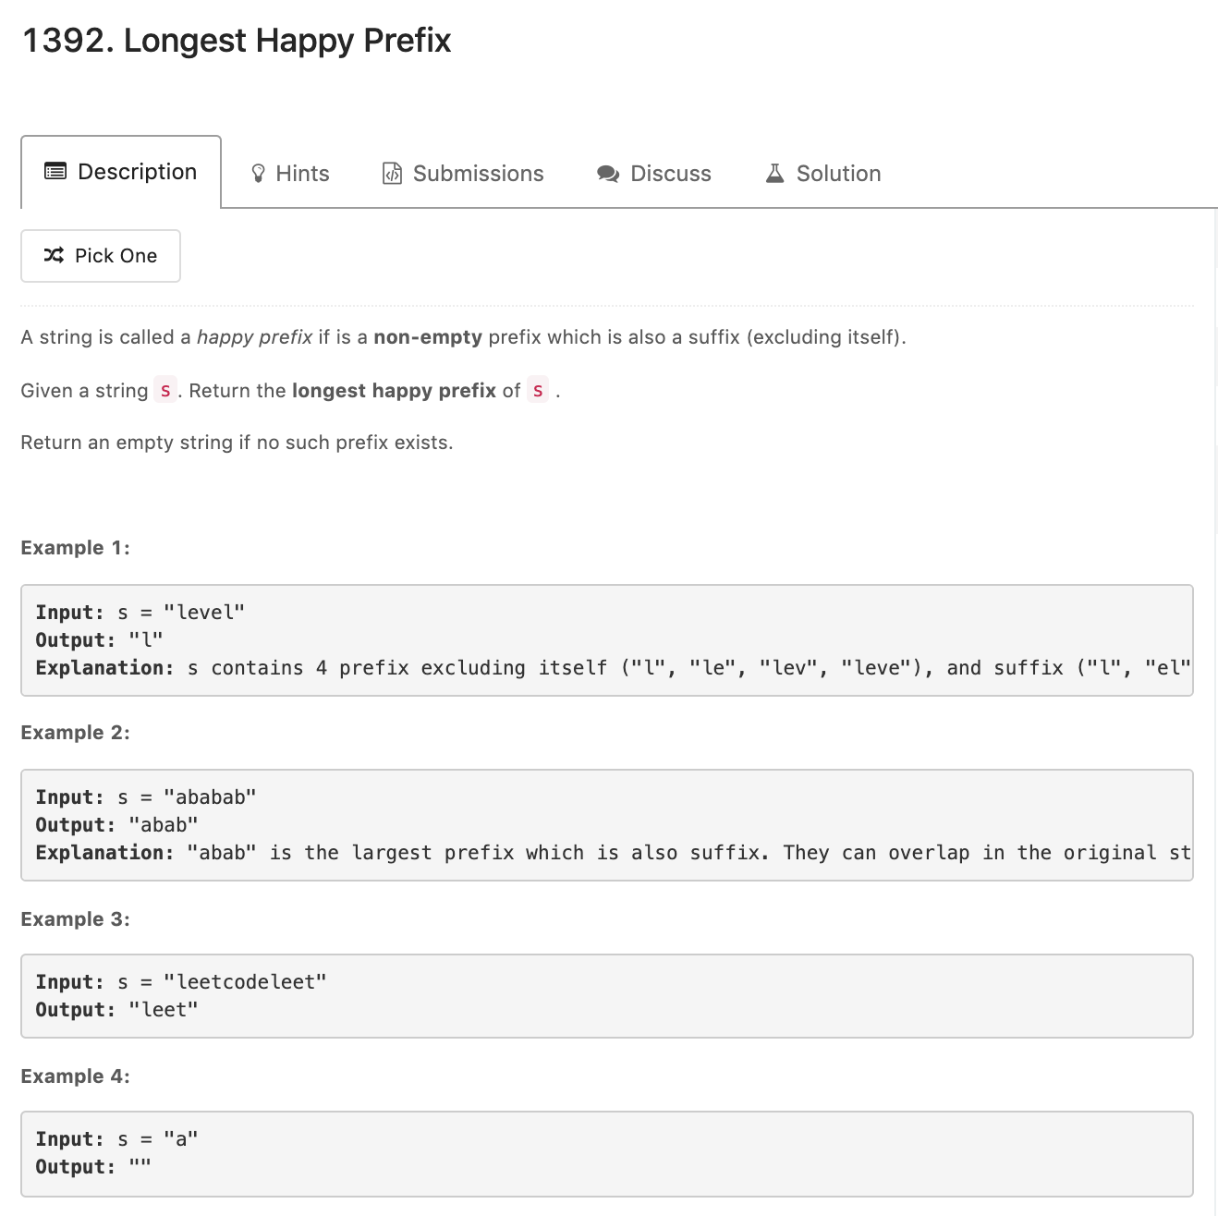
Rolling hash concept:
Increment hash

Slide 12
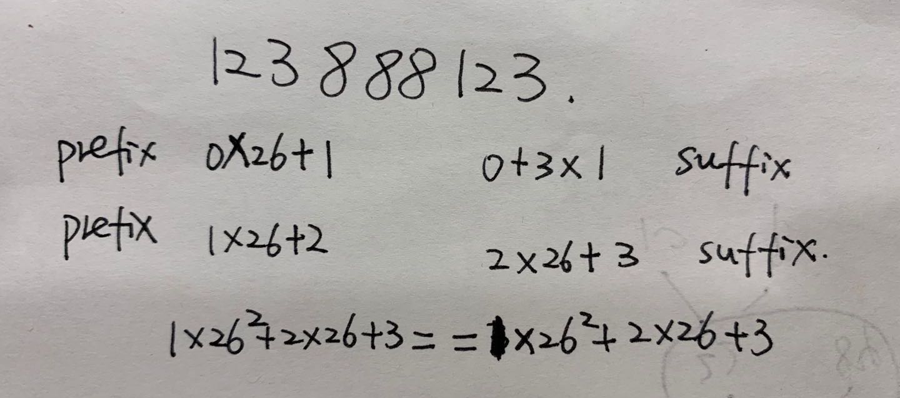
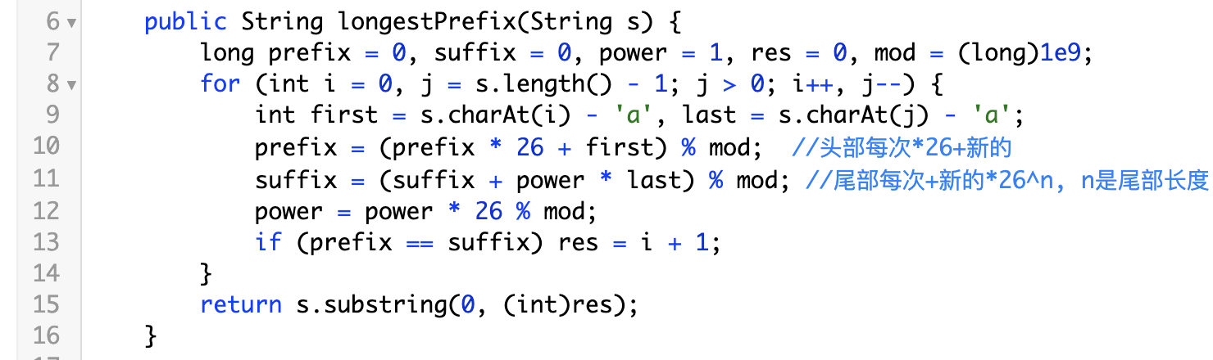
We have two pointer from start and end, we calculated the hasValue of
hash[0, start]
hash[end, n.length - 1]
To check if they are the same

Slide 13
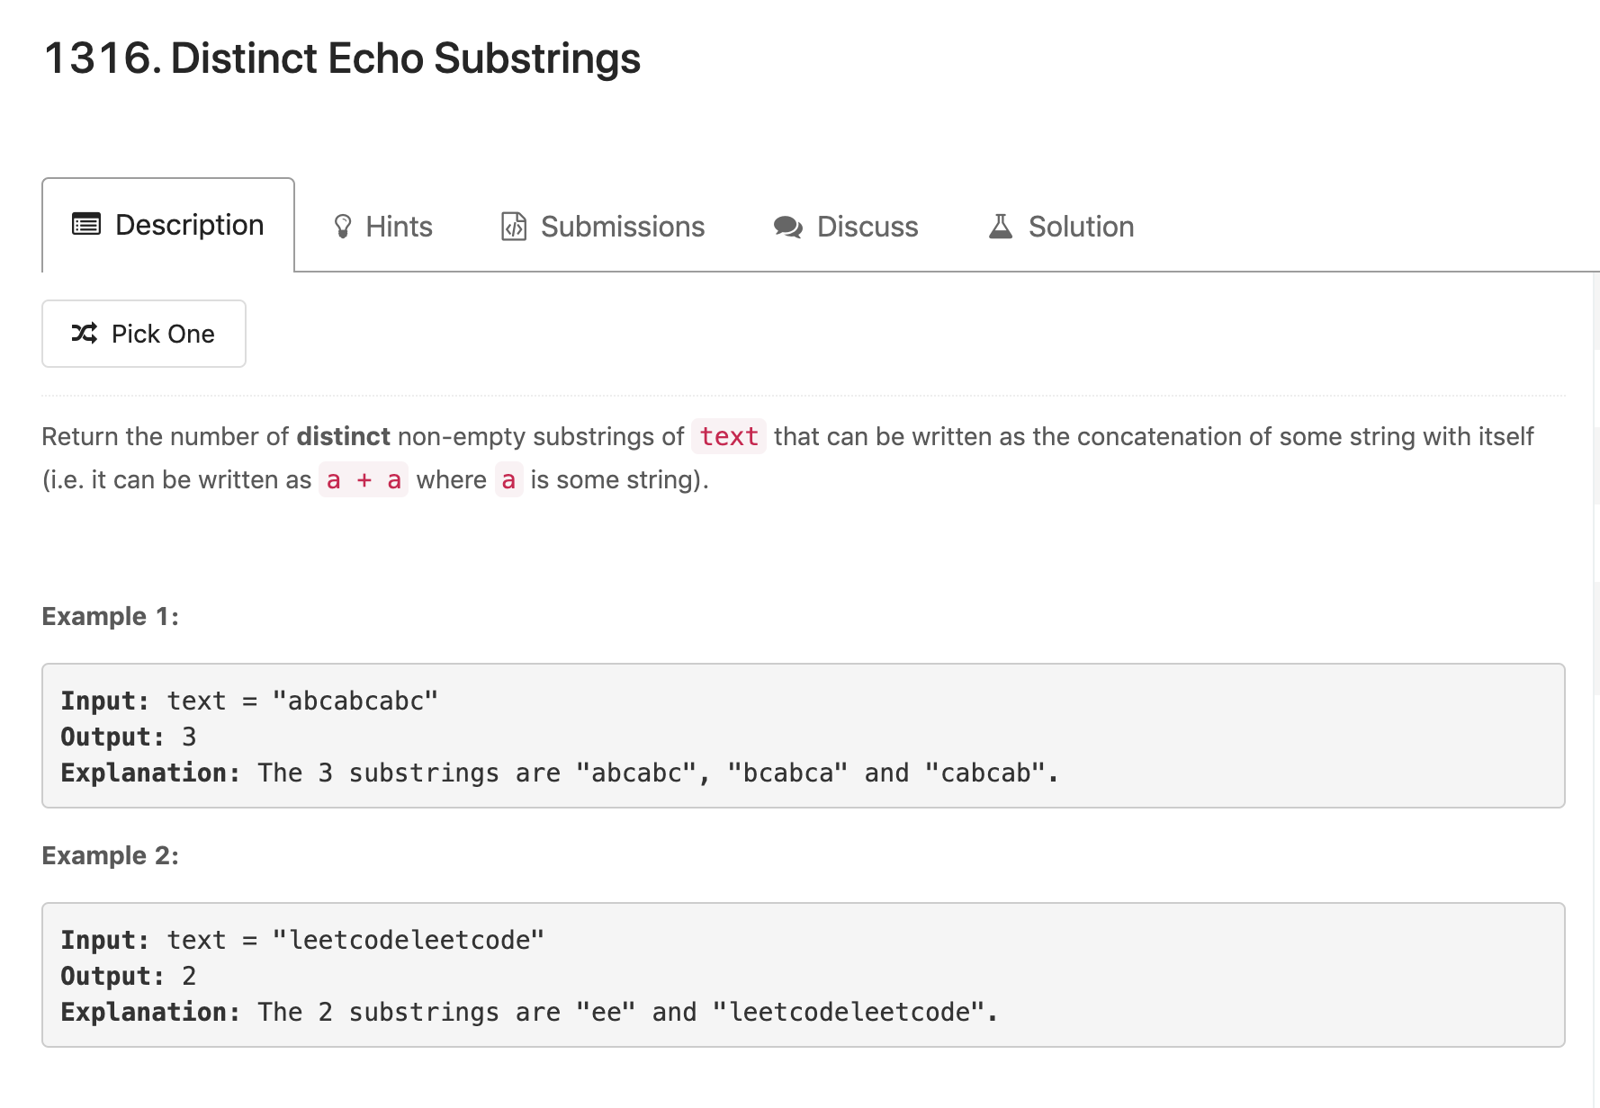
preFix sum(hash), at every index, we compare the follow [i, j] [i + j, i + 2 * j]

Slide 14
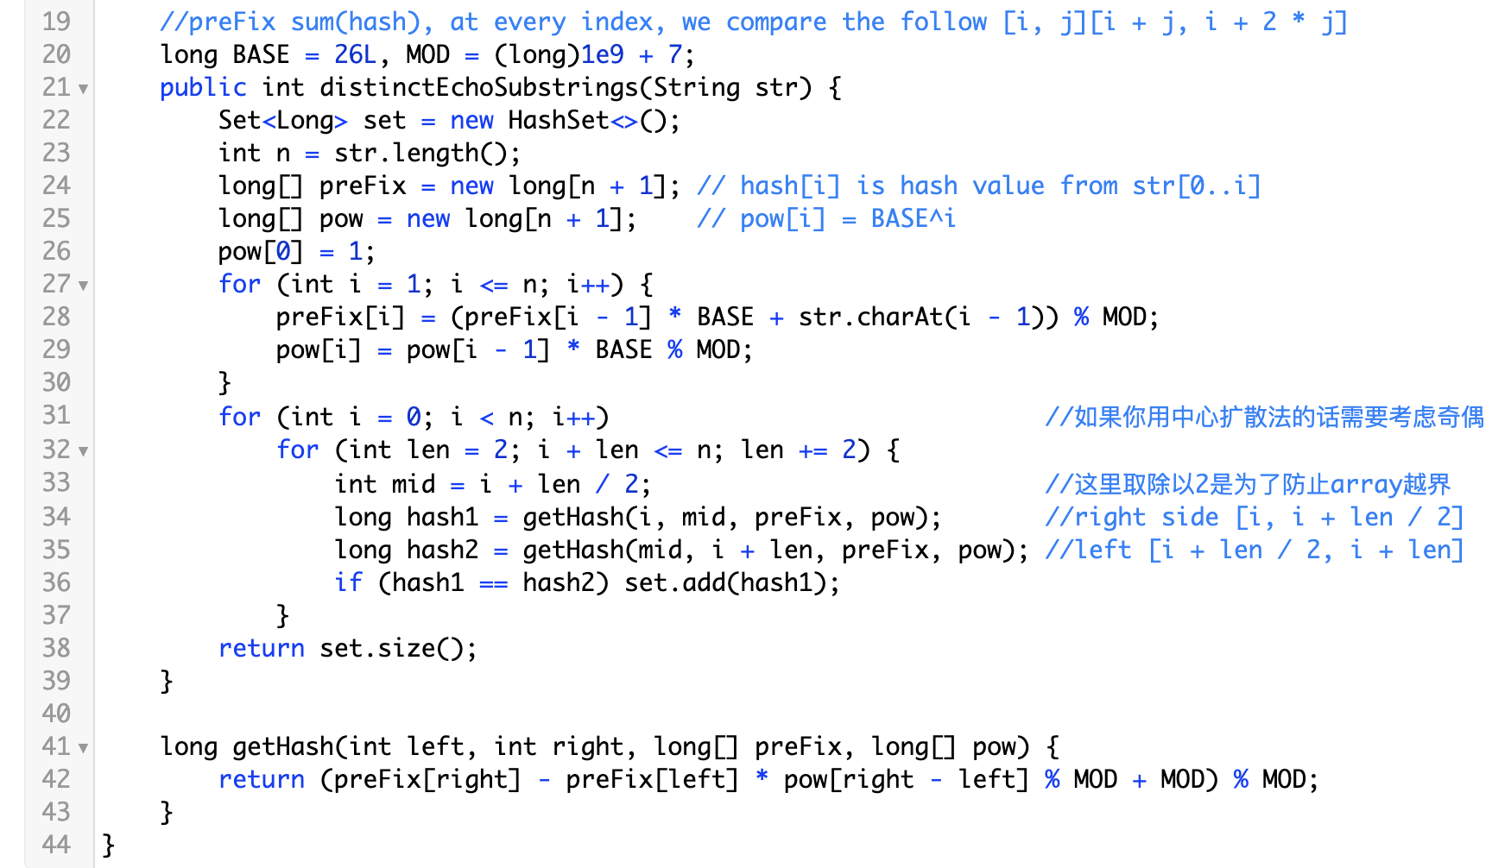
abcabc
Compare a -> b
Compare ab -> ca
Compare abc -> abc
Compare b -> c
Compare bc -> ab
Compare c -> a
Compare ca -> bc
Compare a -> b
Compare b -> c

Slide 15
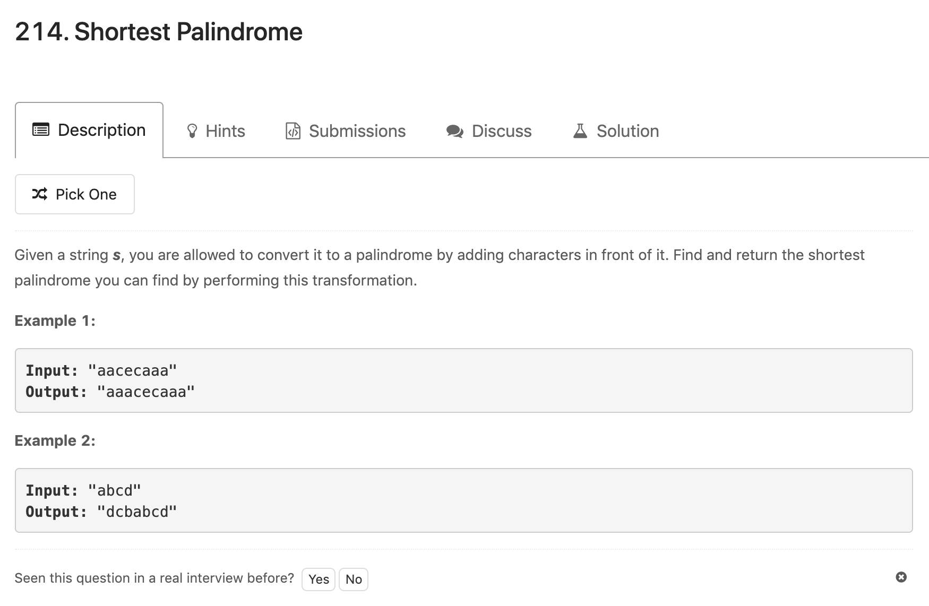
find the longest palindrome in s which starts from index = 0

Slide 16
There is no palindrome, we need to adding all characters in front of it
abcd -> 1234 (character to int for simplify)
Base = 26
Index = 0 (a) index=1(ab) index=2(abc) index=3(abcd)
hashValue left = 0*1+1=1 1 * 26 + 2=28 28 * 26 + 3 = 731 731*26+4=19010
hashValue right = 0+1*26^0=1 1 + 2 * 26=53 53 + 3 * 26^2 = 2081 2081+4*26^3=72385

Slide 17
There is some palindrome, we need to add 4 in front of it to get 41214
abad -> 1214 (character to int for simplify)
Base = 26
Index = 0 (a) index=1(ab) index=2(aba) index=3(abad)
hashValue left = 0*1+1=1 1 * 26 + 2=28 28 * 26 + 1 = 729 729*26+4=18958
hashValue right = 0+1*26^0=1 1 + 2 * 26=53 53 + 1 * 26^2 = 729 729+4*26^3=71033
We find a palindrome as “aba” which mean we only need to append the rest of the string to front

Slide 18
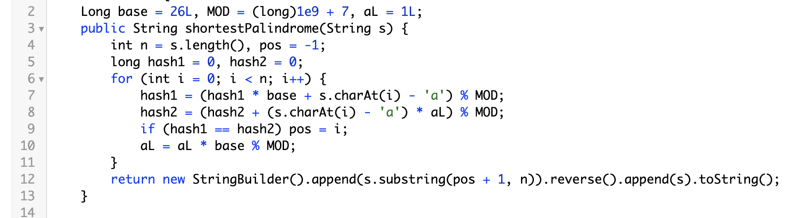
We find the longest palindrome in s which starts from index = 0

Slide 19
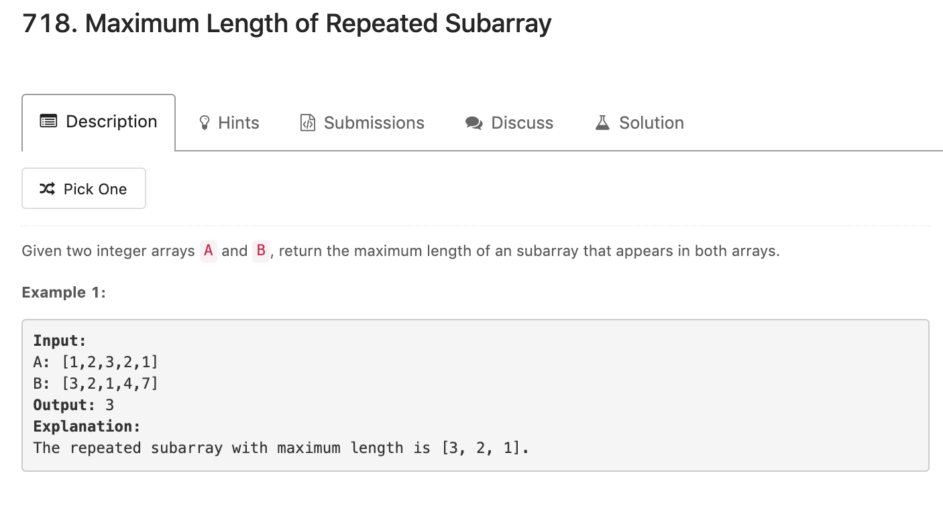
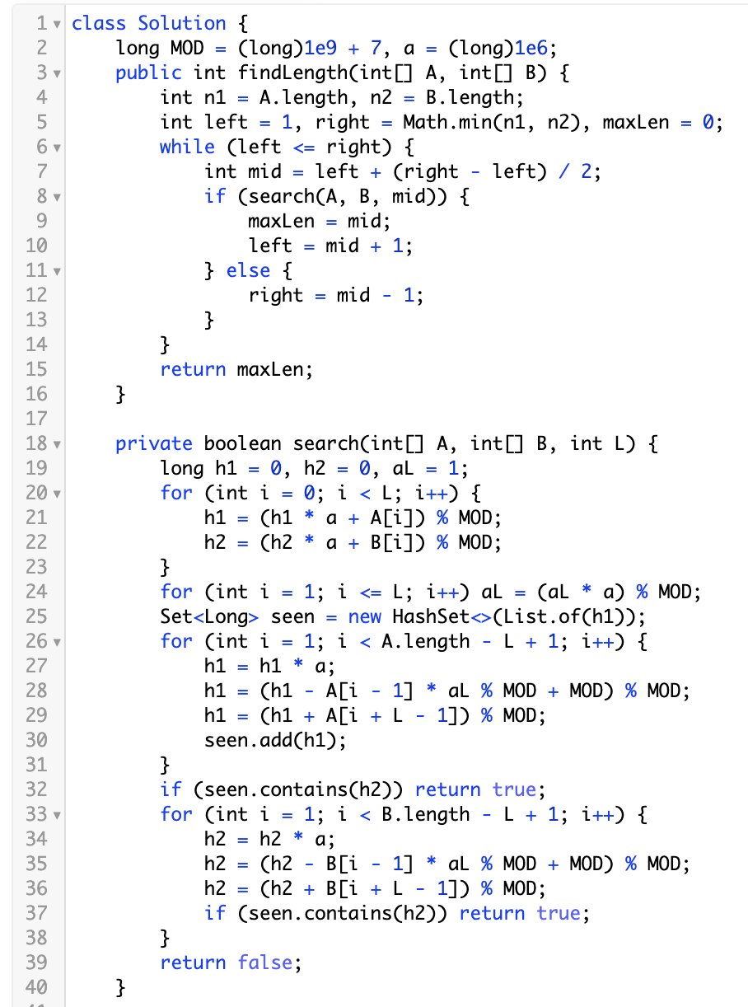
Binary Search + rolling hash
We guess length L, if L is valid, we increase left, otherwise we decrease right;
In seach function, we calculate A’s window size = L hashValue, and check if any B has same window size = L hashValue

Slide 20
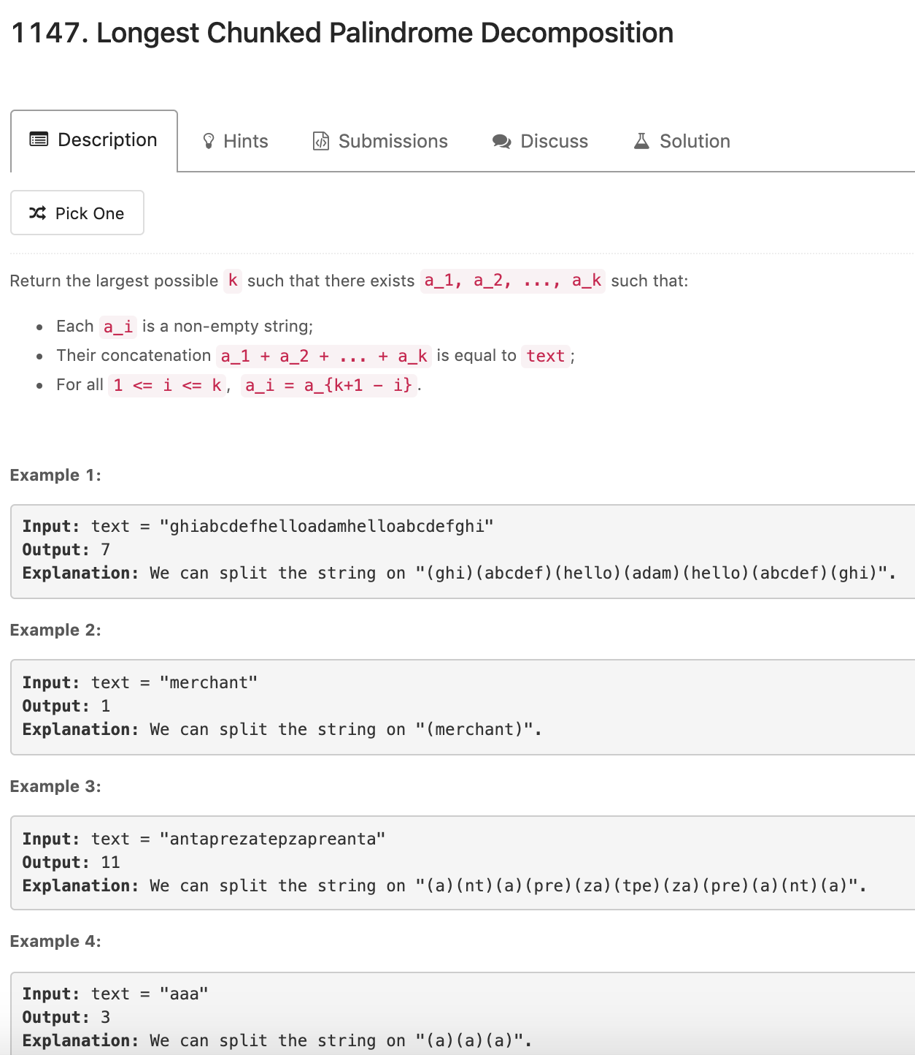
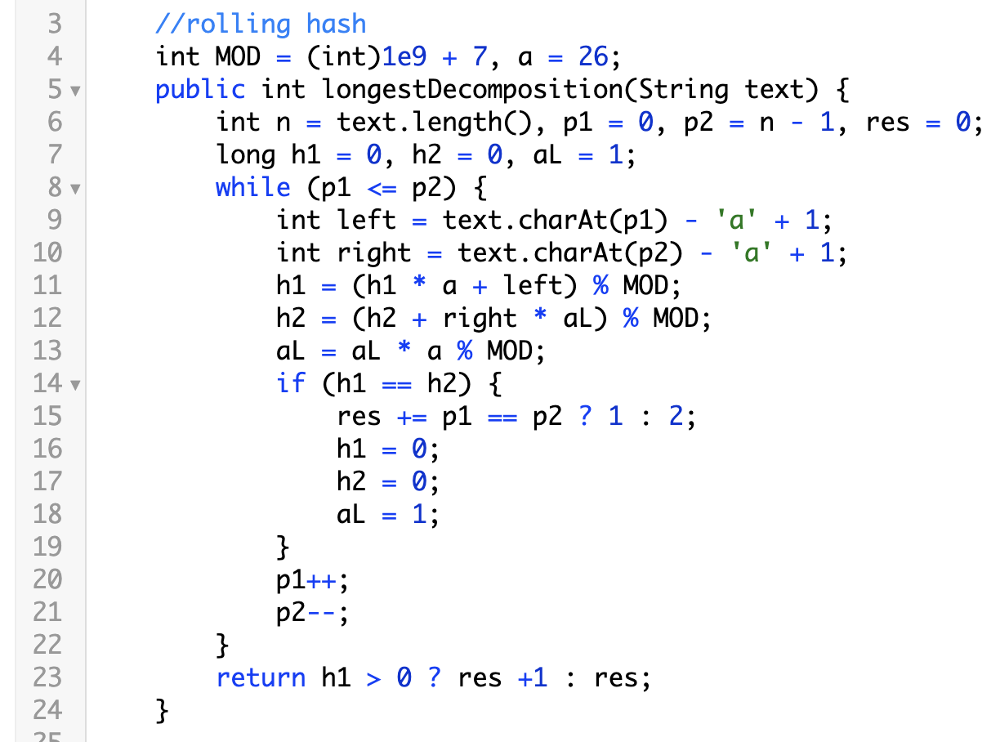
We have two pointers start, end
We compare [0, start] and [end, n - 1]
If their hashValues are same, res += 2

Slide 21
Rolling hash summary
Basically a sliding window way to calculate length L’s hashValue in string in O(n) time, can be compared with it self (repeat substring) or compare with another string (find common substring in A and B)
Usually combined with binary search to find the correct length L, the total time complexity would be O(nlogn)

Slide 22
Next week
Reservoir sampling
Java heap implementation
Git normal usage
More if you think is a better topic please ping @Abby

